Slide 1
Fix Match : Semi Supervised Learning
Reference – https://arxiv.org/pdf/2001.07685.pdf

Slide 2

Department of IT, Shri G.S. Institute of Technology and Science, Indore Date 10-04-2021 Guided By – Dr. Neeraj K. Rathore , Mr. Upendra Singh
Group No. – G8
Presented by –
Harshit Tripathi – 0801IT171032, Jitendra Sharma – 0801IT171034, Naman Malpani –0801IT171050

Slide 3
Table Of Contents
System Design
Architectural Design
Algorithm Used
Code Section
Output – Analysis
Future Scope
References

Slide 4
System Design

Slide 5
Here we are performing comparative study SSL algorithm due to which the system design is very simple.
Different deep learning models.
FixMatch algorithm -
FixMatch is a combination of two approaches to SSL: Consistency regularization and pseudo-labeling. Its main novelty comes from the combination of these two ingredients as well as the use of a separate weak and strong augmentation when performing consistency regularization.

Slide 6
Architectural Design

Slide 7
Architectural Design ( Building Blocks Description)
Strong Augmentation
Horizontal Flip
Vertical Flip
Rotate ( 90 , 180 , 270)
Shear X, Shear Y
Translate X , Translate Y
Auto-Contrast , Invert
Equalize , Flip
Solarize
Color , Brightness , Sharpness
Cutout
Note - Selecting at random 1 or more type of augmentation of above and magnitude of the above ranging from (0-30)
Weak Augmentation
Horizontal Flip
Vertical Flip
Rotate ( 90 , 180 , 270)
Note - Selecting at random 1 or more type of augmentation of above

Slide 8
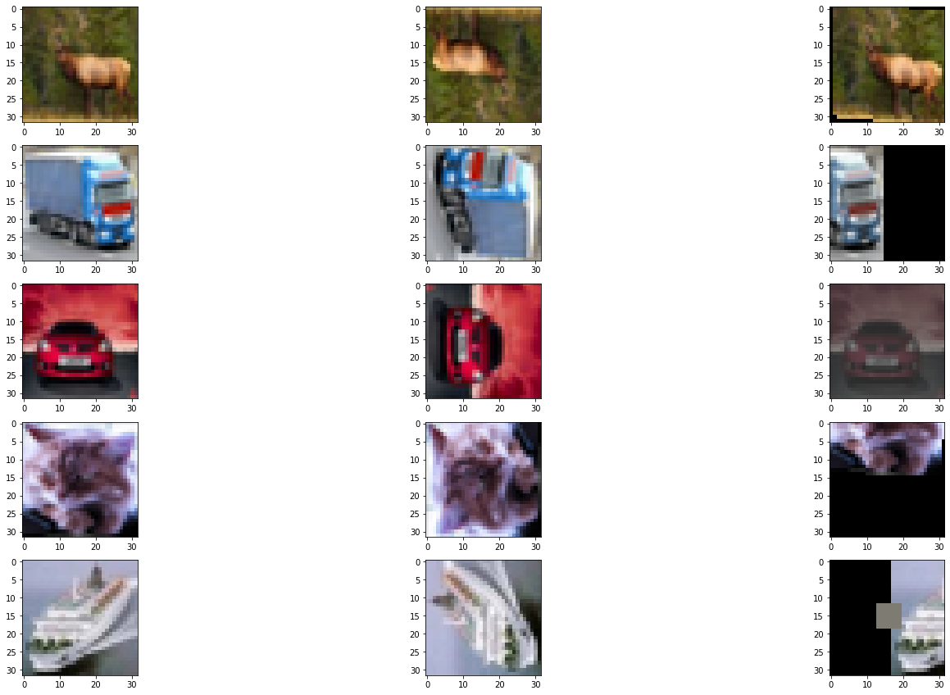
Augmentation Visualization
Original Image
Weak Aug
Random Aug

Slide 9
Architectural Design ( Building Blocks Description)
Convolution Models –
VGG – 16
Resnet-50
Resnet-34
Google net
VGG – 16 (modified with the regularization & dropout rate)
Further to be explored
References –
https://www.jcancer.org/v10p4876.pdf
https://arxiv.org/pdf/1512.03385
https://research.google.com/pubs/archive/43022.pdf

Slide 10
Algorithm Used

Slide 11
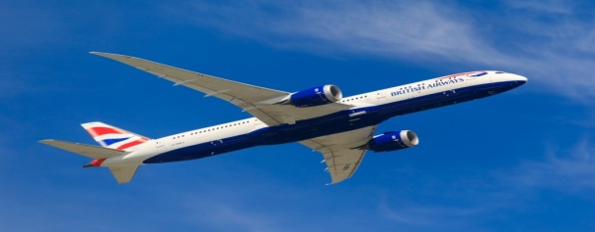
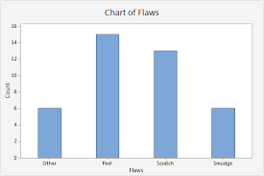
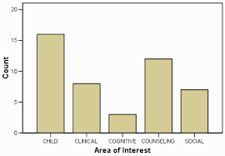
Input Image
(32 * 32 * 3 )
Rotating images , Scale , Shear , Flip , Light , Hue , etc
Image Data Generator
Model
Splitting the dataset into train , testing and validation
Converting the images set to numpy array format, and normalization
Weak Augmentation of Image
Pseudo Label
Minimizing Loss
Strong Augmentation of Image

Slide 12
Code Section

Slide 13
Output Analysis

Slide 16
As we increase the threshold value from range 0.1 to 0.9 we have observed that there is a decrement in accuracy of the model but the deviation is quite minimal till the Unlabelled/Labelled Ratio of dataset is 0.8 which is nearly by 2% , afterwards the decrement is considerably more.
The shallower network of VGG - 16 and its modified version with the dropout layer is outperformed from the deeper Convolution Model such as Resnet - 50 and Resnet - 18 which is due the over-fitting in the graph (the model has better accuracy for the training dataset but it is not generalized for the overall image dataset and lead to high error rate in test dataset which is due to high variance) for deeper model as compared to VGG-16 which can be concluded from the above graph.
The accuracy by varying the threshold from 0.95 to 0.9 we have observed that with threshold 0.9 it has a better accuracy, by consider all the other parameter such that optimizer, epochs to be same for both the results.

Slide 17
Future Scope

Slide 18
Since it has a great achievement in field of machine learning for using the unlabelled images all around the internet to use them for training the machine using fix-match algorithm since this will reduce the cost for making the large dataset for the training purpose for supervised learning and here the semi-supervised learning has an edge for get the remarkable accuracy with least deviation and with large number of unlabel data with some label data.

Slide 19
References
https://www.coursera.org/learn/machine-learning
https://www.cs.toronto.edu/~kriz/cifar-10-python.tar.gz
https://amitness.com/2020/03/fixmatch-semi-supervised/

